Slide 1
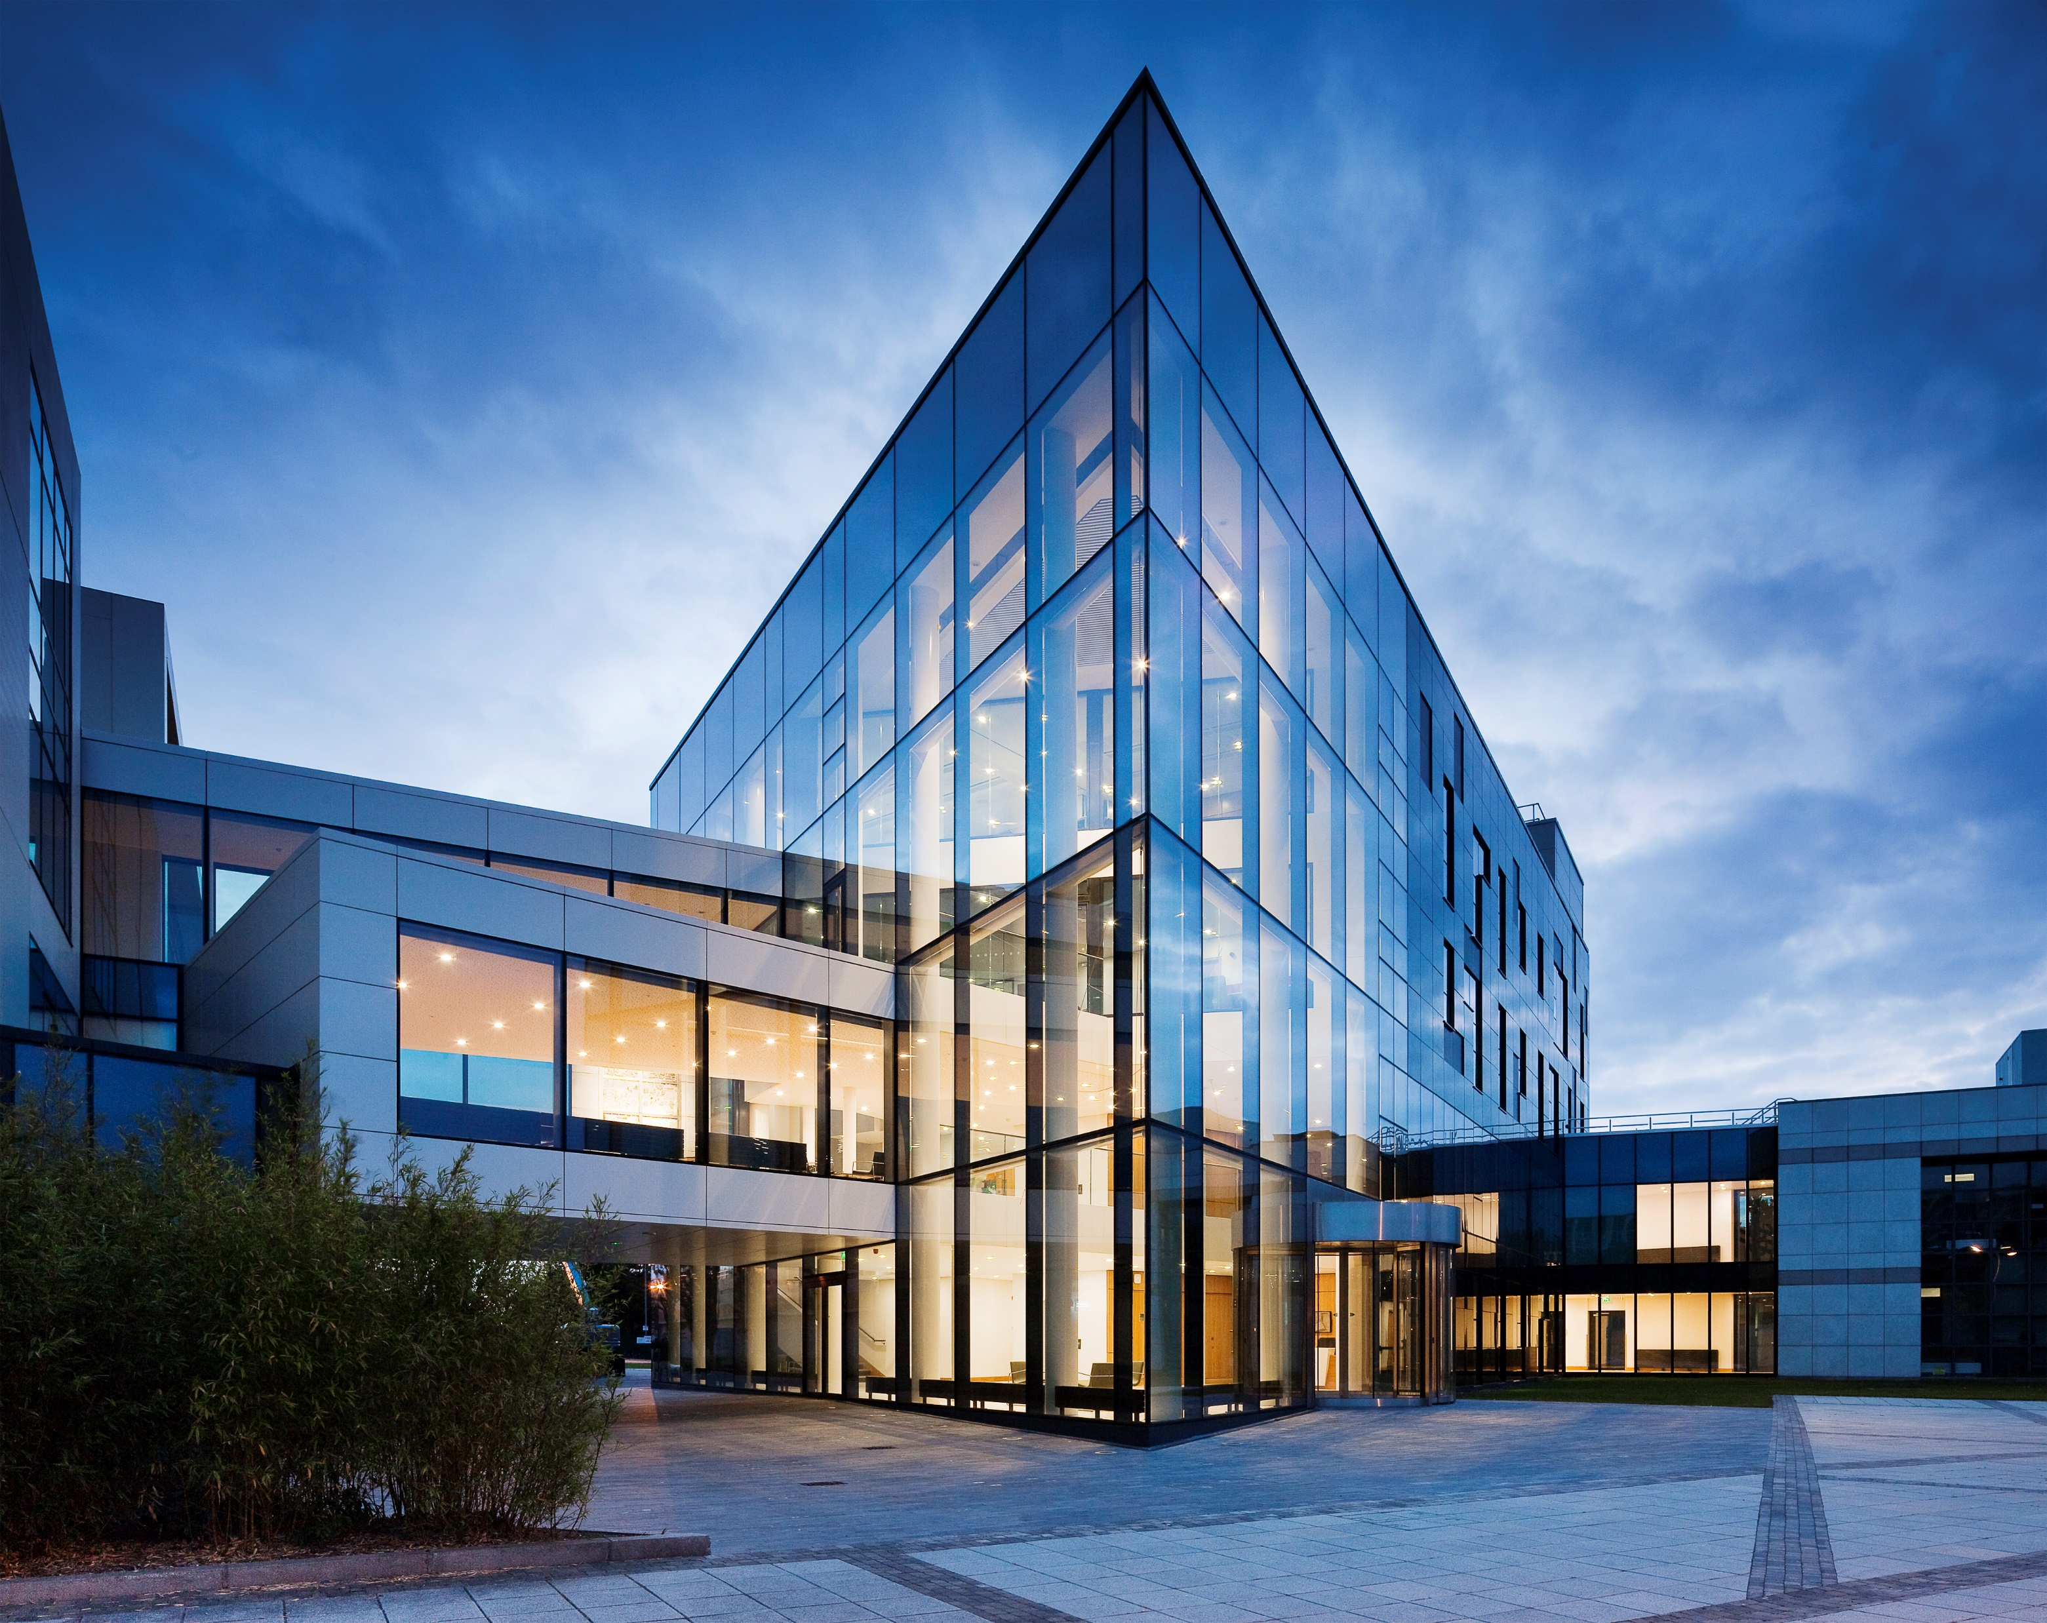
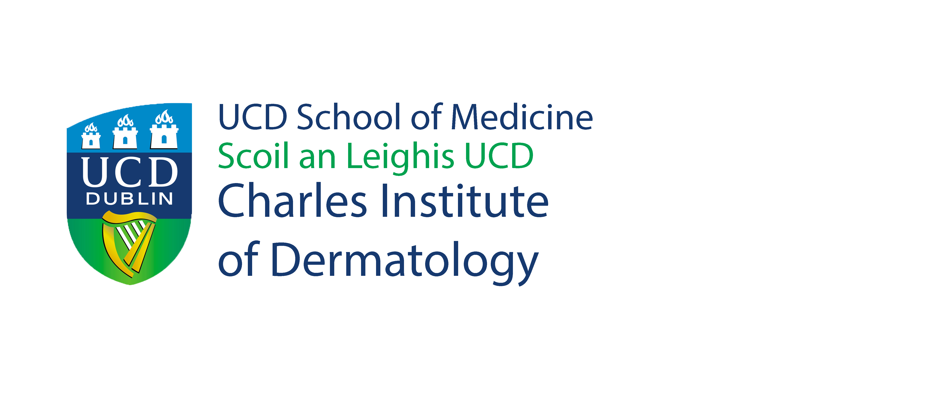


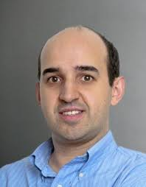
Ireland’s National Dermatology
Research & Education Centre
The Charles Institute Seminar Series
Wednesday 7th September 2022 @ 12 noon
Charles Seminar Room & Online via Zoom
Molecular mechanisms of melanin transfer and processing
Duarte C. Barral, PhD
NOVA Medical School, NOVA University of Lisbon
BIO: Duarte C. Barral completed the Degree in Microbiology and Genetics from the Faculty of Sciences, University of Lisbon, and the PhD in Cell Biology from Imperial College London. He was a Post-Doctoral Fellow at Brigham and Women's Hospital, Harvard Medical School until he took a position as Principal Investigator at NOVA Medical School, NOVA University of Lisbon. He is currently a tenured Associate Professor at the same School. He has been working in the field of membrane traffic and its regulation by GTPases of the Rab and Arf families for more 20 years. He has helped uncover the previously unknown role of several of these proteins, namely Rab27a, Arl8b, Arl13b, and Rab35. Duarte Barral published 50 articles in peer-reviewed international journals (h-index 26) and 2493 citations.
Abstract: Skin pigmentation relies on the pigment melanin, which protects skin cells against ultraviolet (UV) radiation-induced damage. Melanin is produced by melanocytes and then transferred to keratinocytes, where it is processed and forms supra-nuclear caps. Despite the crucial role of melanin secretion, transfer and processing by keratinocytes for skin pigmentation, the pathways involved remain controversial and poorly characterized. We have been studying these processes by characterizing the pathways and regulators involved. We found that basal melanin secretion is regulated by Rab11b and the exocyst complex; that melanin uptake occurs through PAR-2, Rac1- and Cdc42-dependent phagocytosis; and that melanin polarization within keratinocytes is dependent on Rab7-mediated transport along microtubules. Furthermore, we uncovered a new melanin exocytosis pathway, stimulated by keratinocyte-conditioned medium and regulated by Rab3a.
  *The Charles Institute Seminar Series is kindly supported by RELIFE. RELIFE had no input into the content of the Series.

